Slide 1
Aviation accidentS Visualization project
Group 3 members:
Arame diasse, Jackie ochuida, Nicholas George, Rajib maji, Stephen grantham, Theresa bravo, Vishnu pillai

Slide 2
Aviation Accidents' visualization
Introduction:
QUESTIONS TO BE CONSIDERED:
Can we accurately predict where plane crashes are about to occur?
Are there certain airlines that have more crashes than others?
Are there possible outside factors affecting these trends?

Slide 3
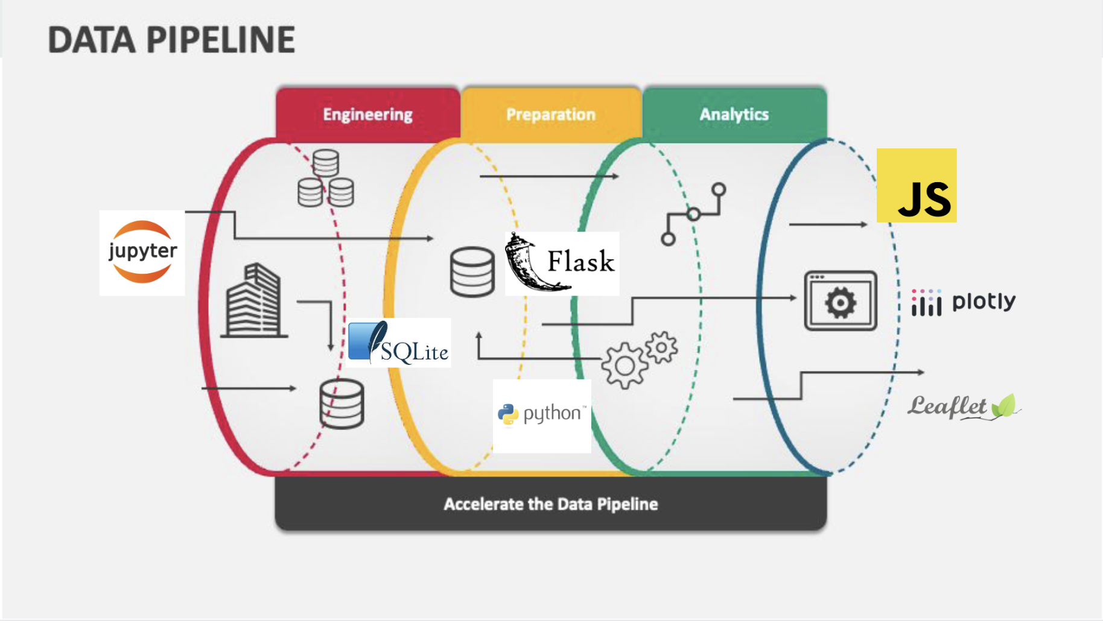
Aviation Accidents visualization
Extraction +
Transformation:

Slide 4
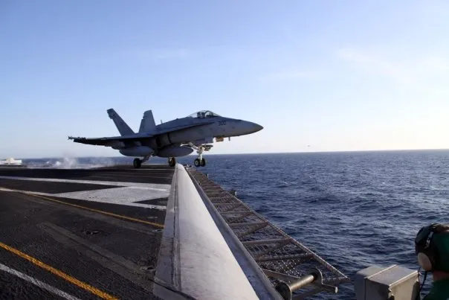
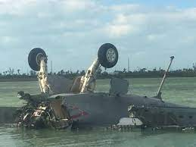
Aviation Accidents visualization
Extraction +
Transformation:
Data Extraction
Web Scraping
Text Parsing
Modules/APIs
Data Transformation
Removal of Unwanted Information
Old/New Names
Standardization

Slide 5
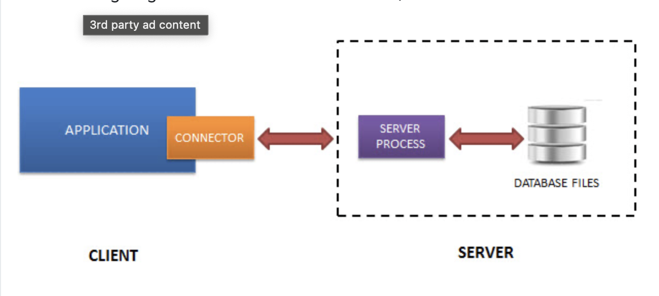
Aviation Accidents visualization
Flask API / SQLite
Database
Loading:

Slide 6
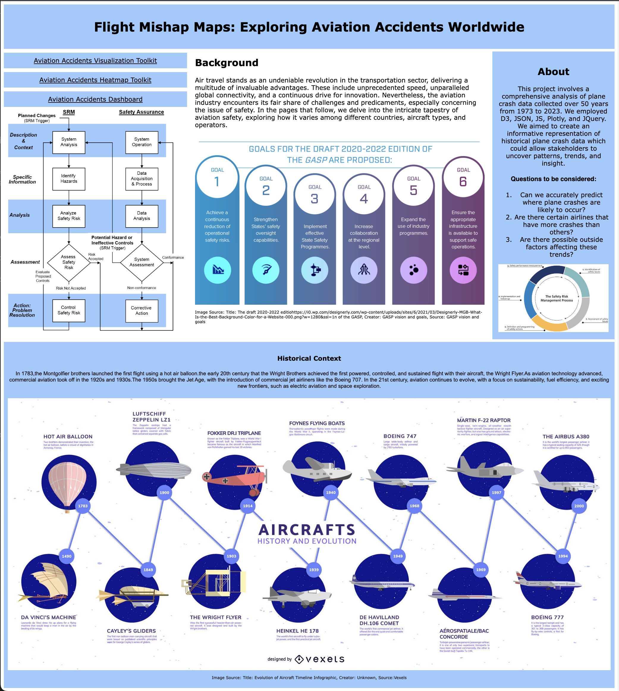
Aviation Accidents Visualization
Landing Page:

Slide 7
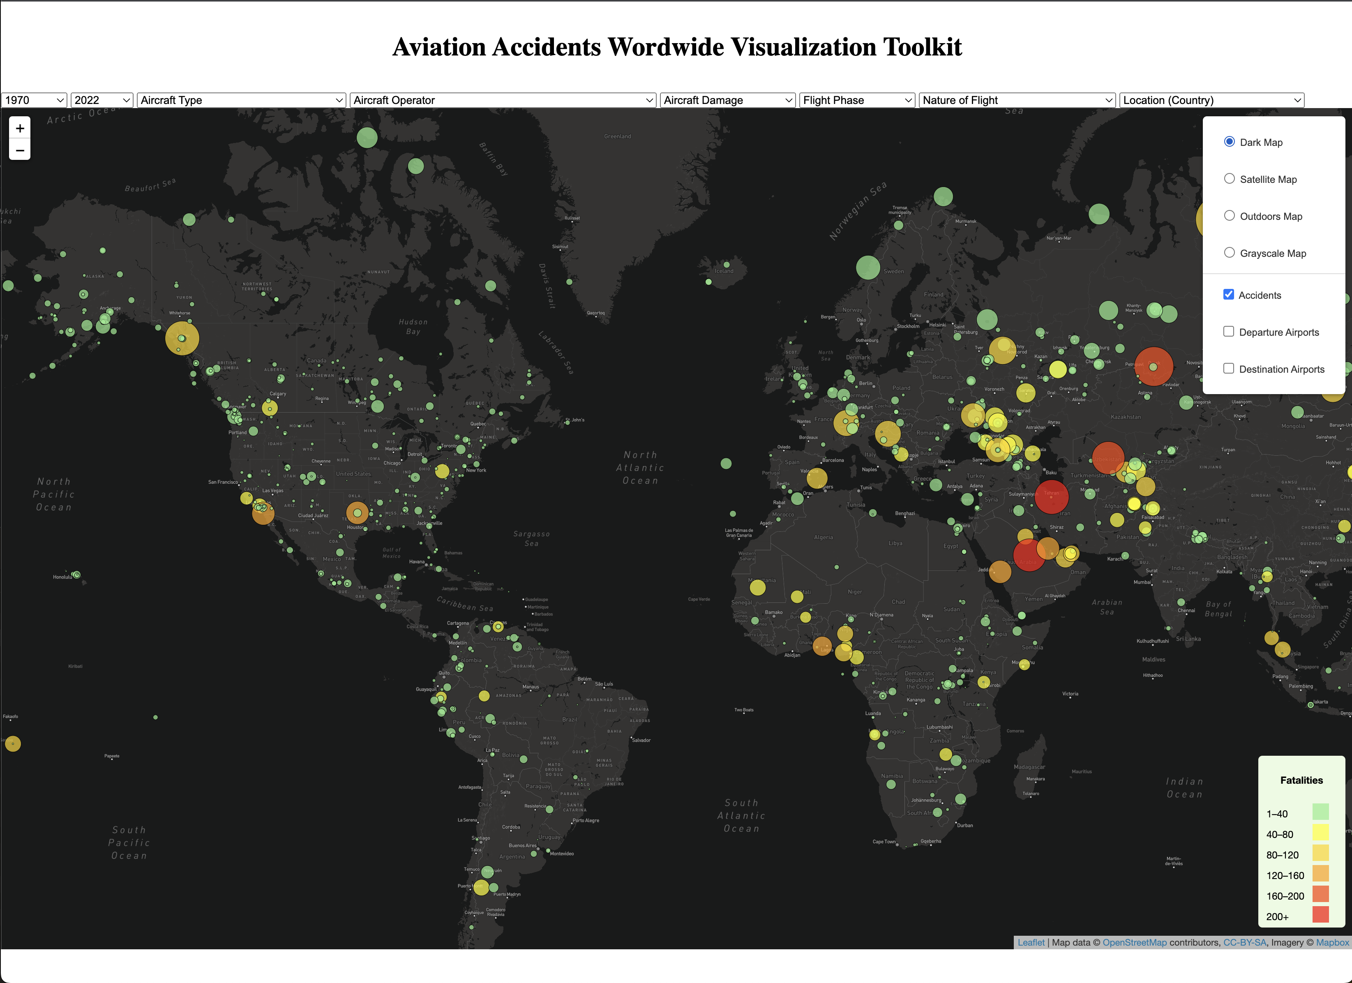
Aviation Accidents Visualization
Visualization:

Slide 8
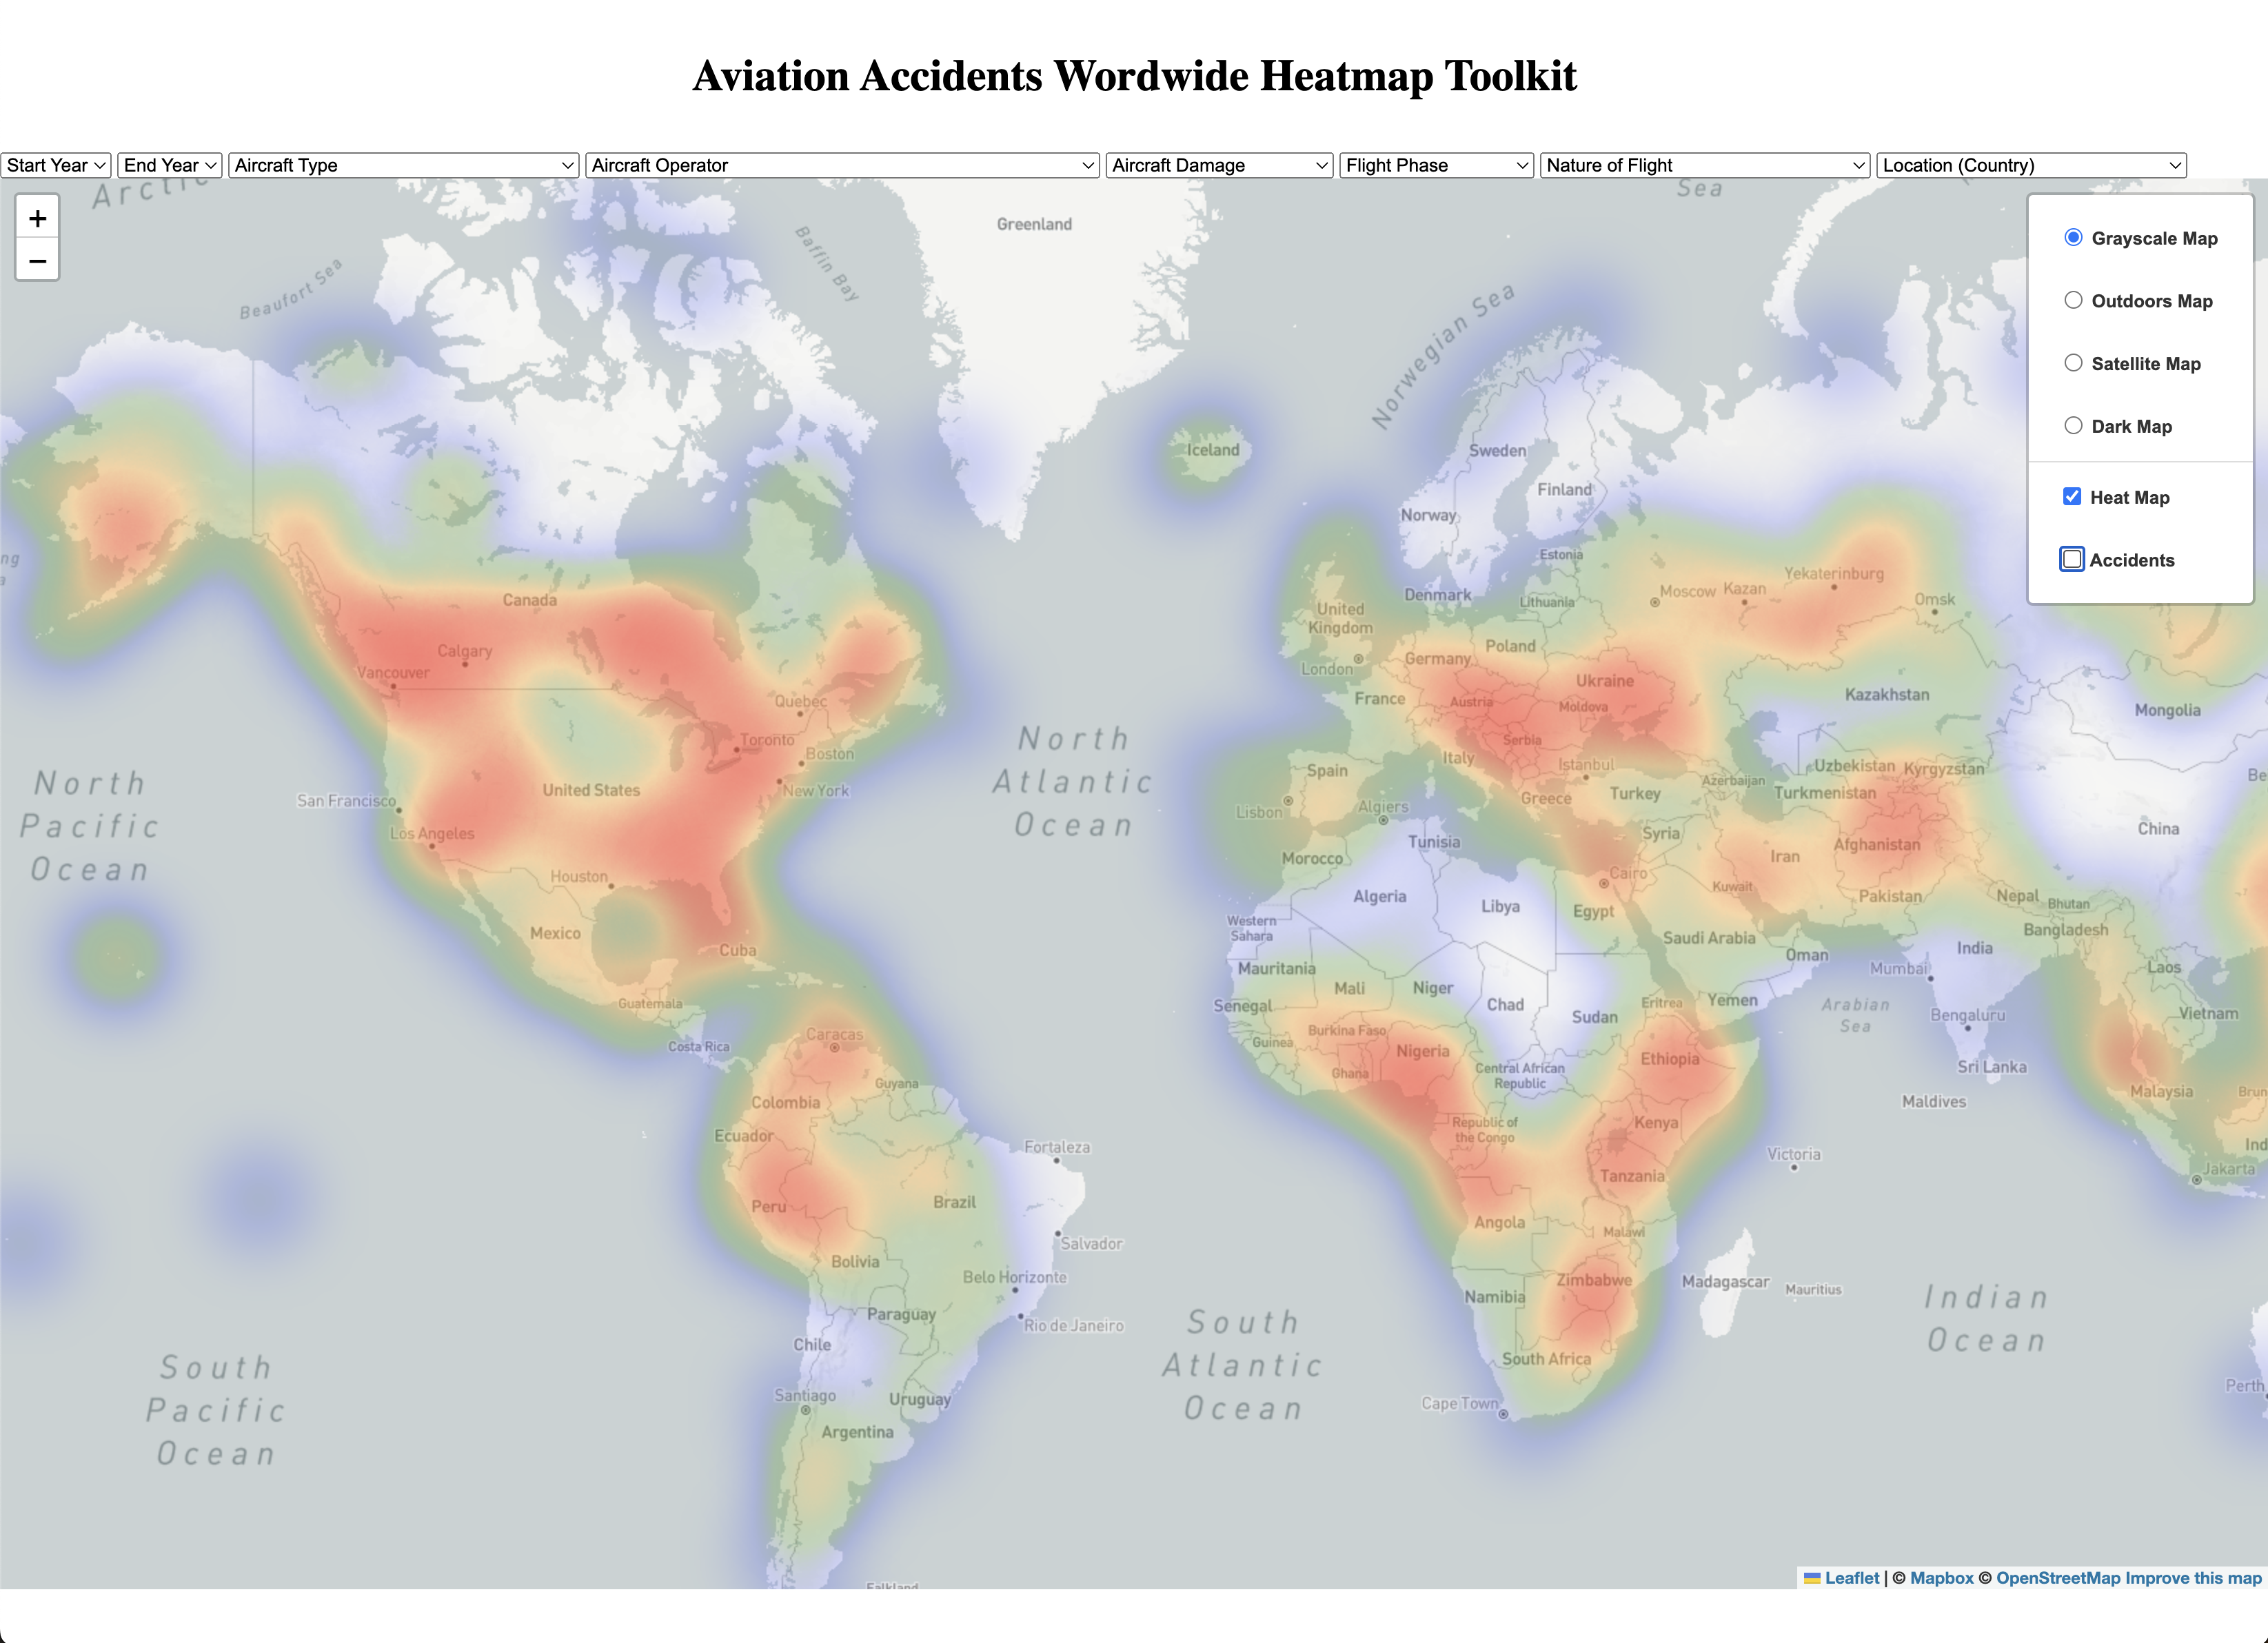
Aviation Accidents Visualization

Slide 9
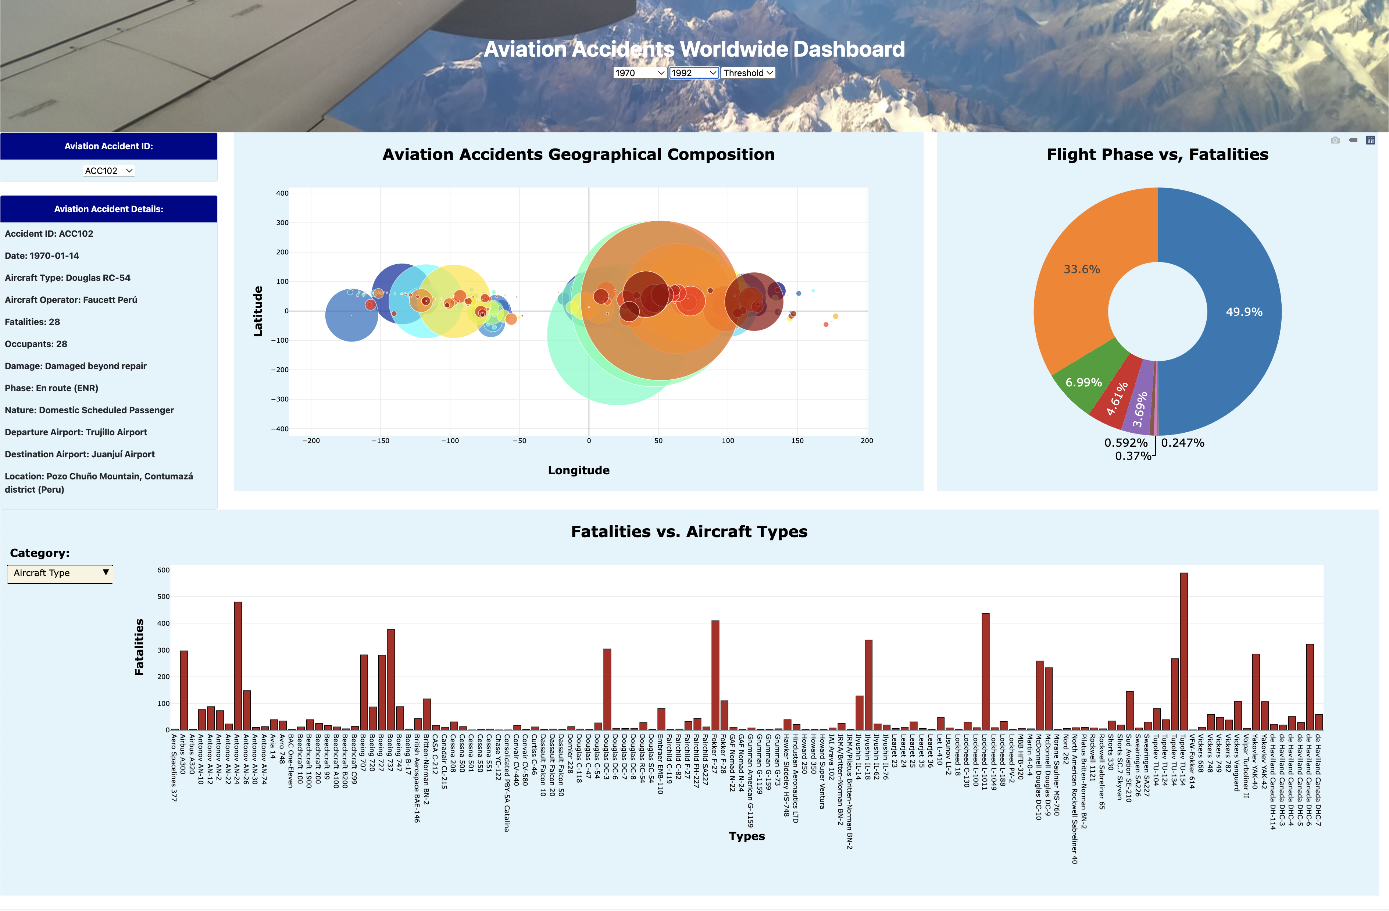
Aviation Accidents Visualization

Slide 10
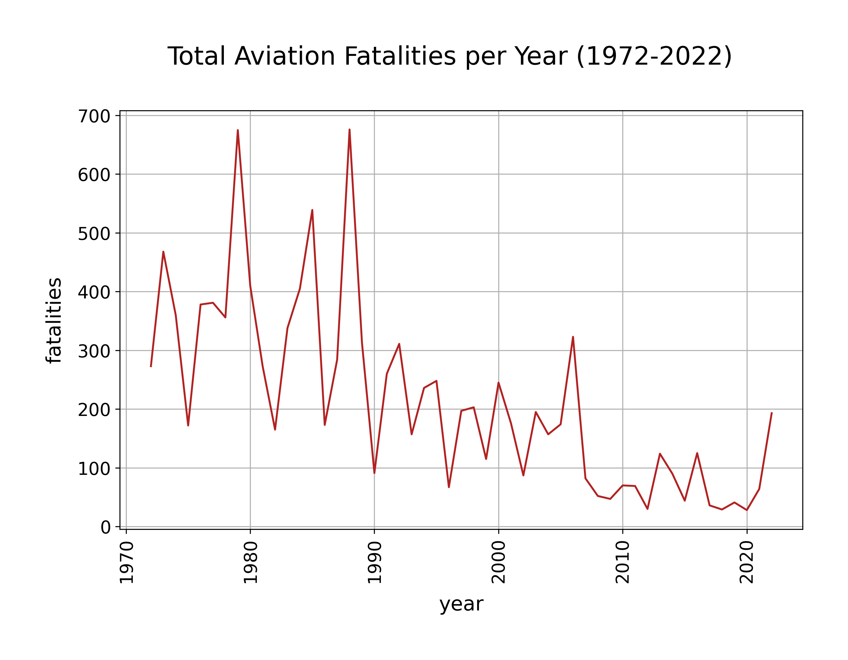
Aviation Accidents Visualization
Analysis:

Slide 11
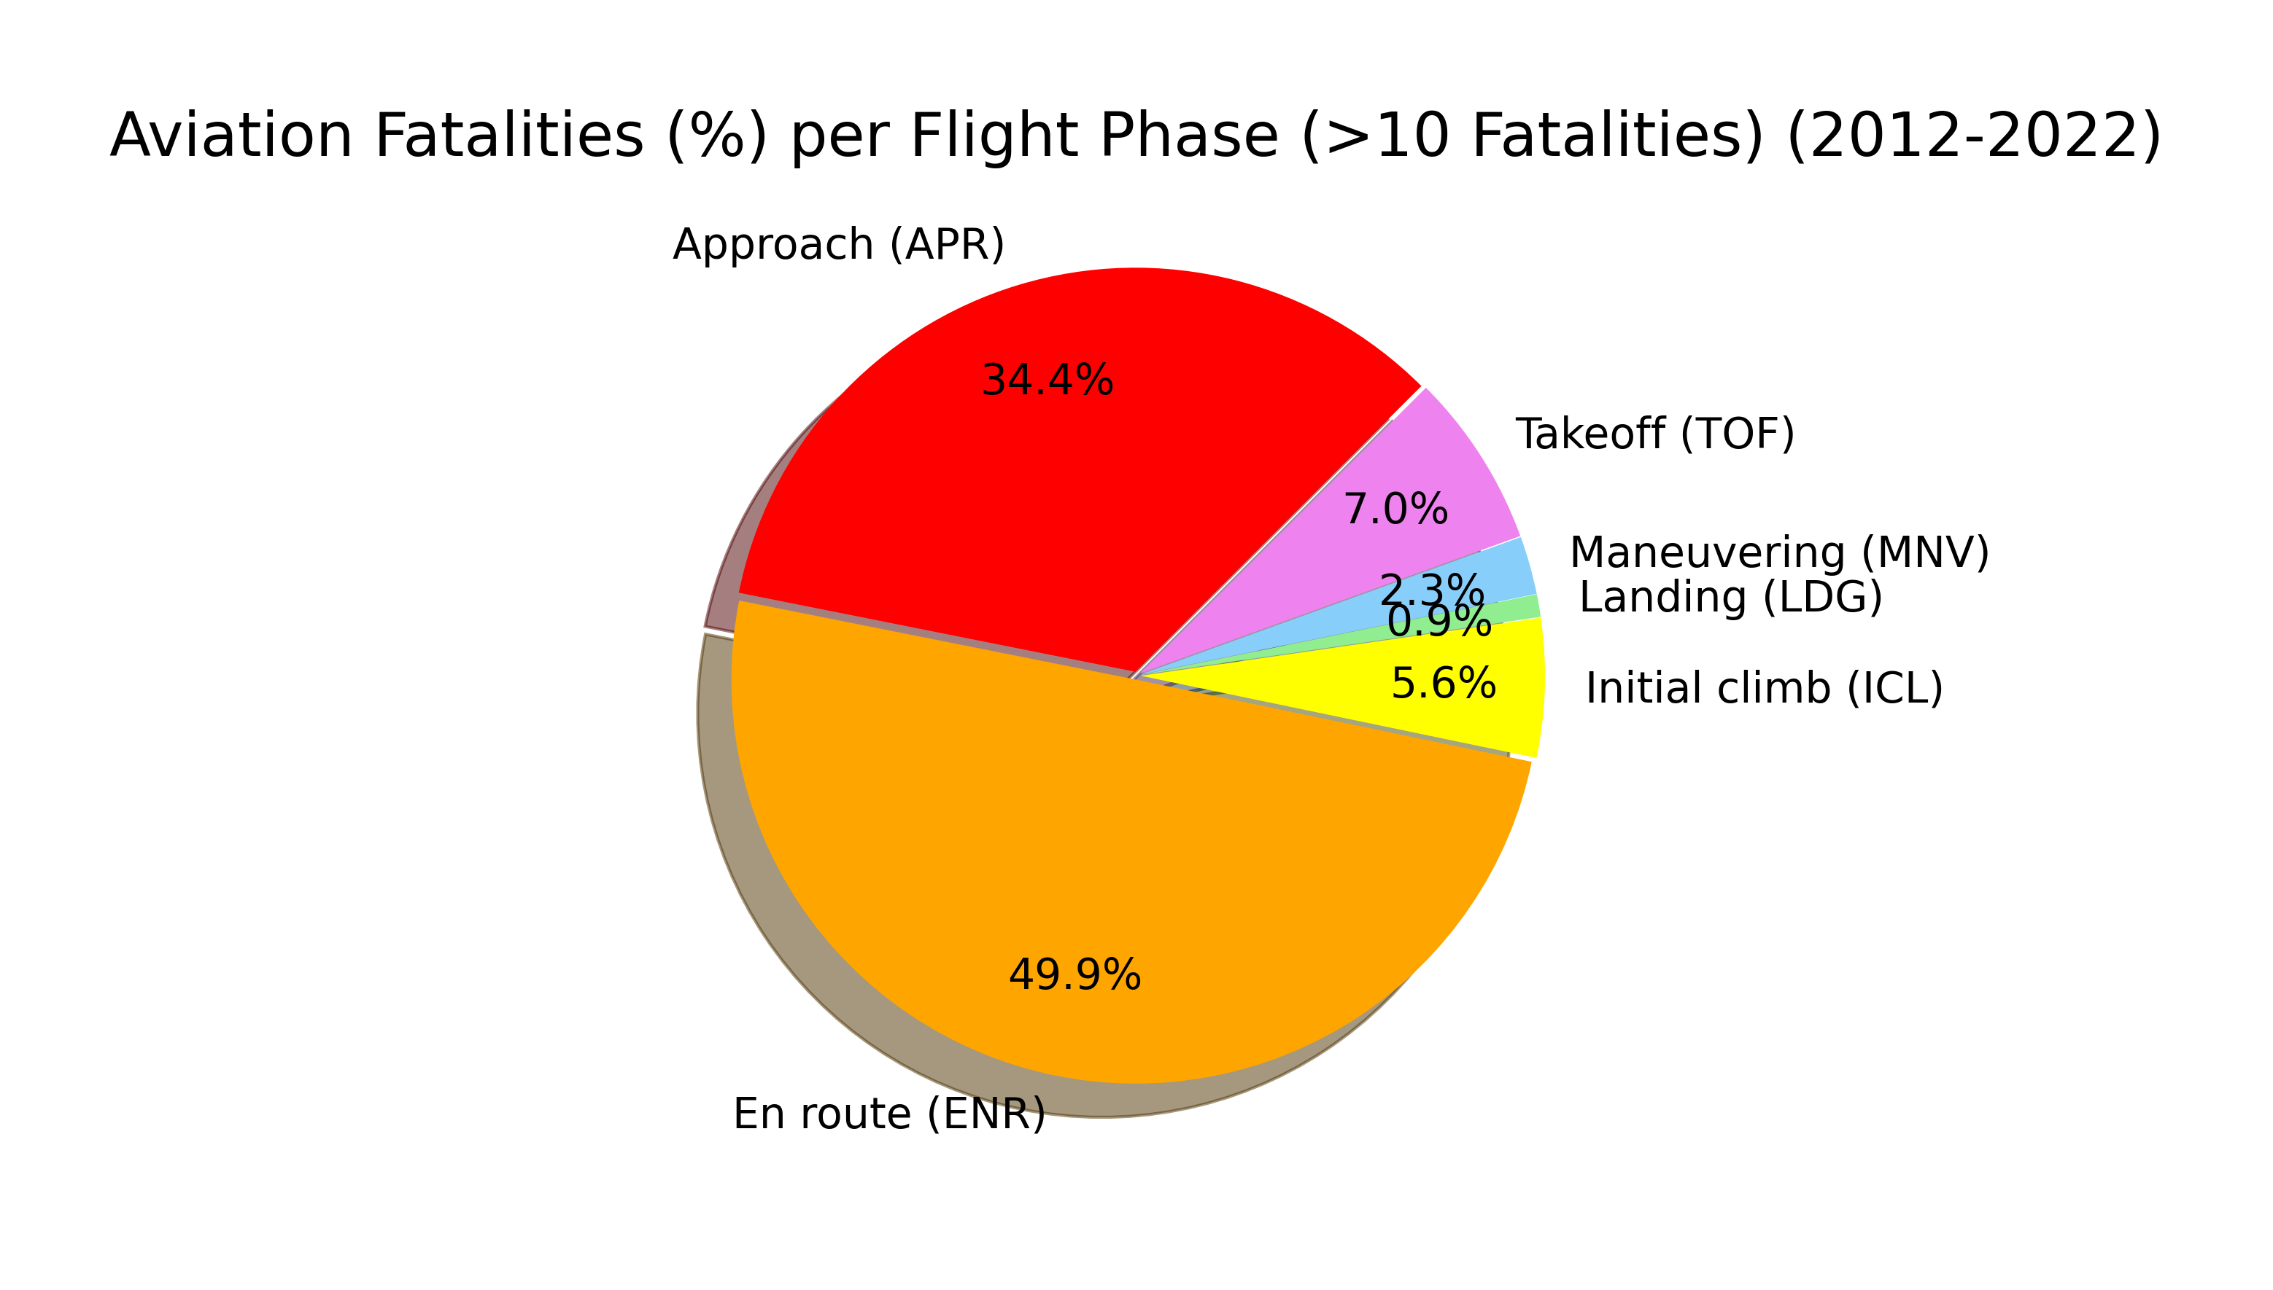
Aviation Accidents Visualization
Analysis:

Slide 12
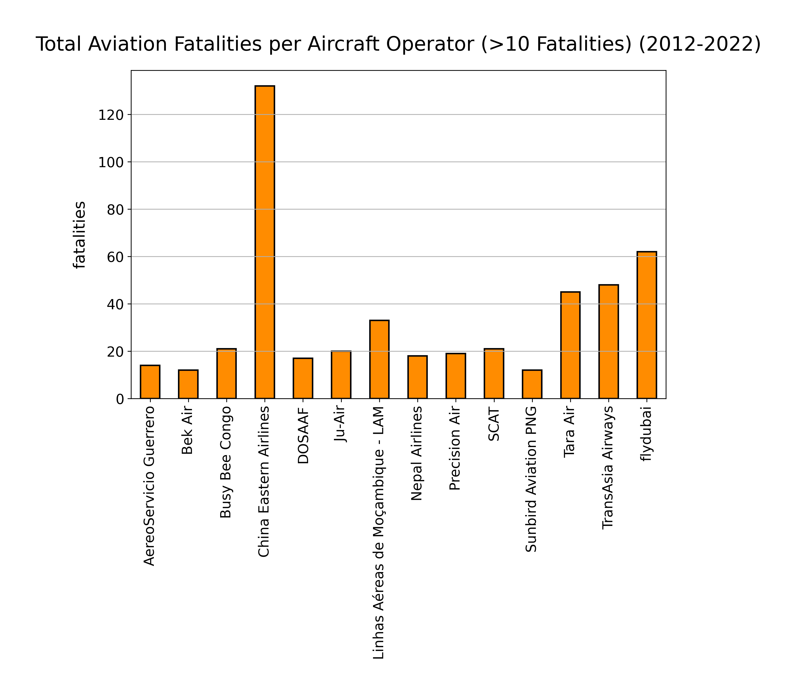
Aviation Accidents Visualization Project
Analysis:

Slide 13
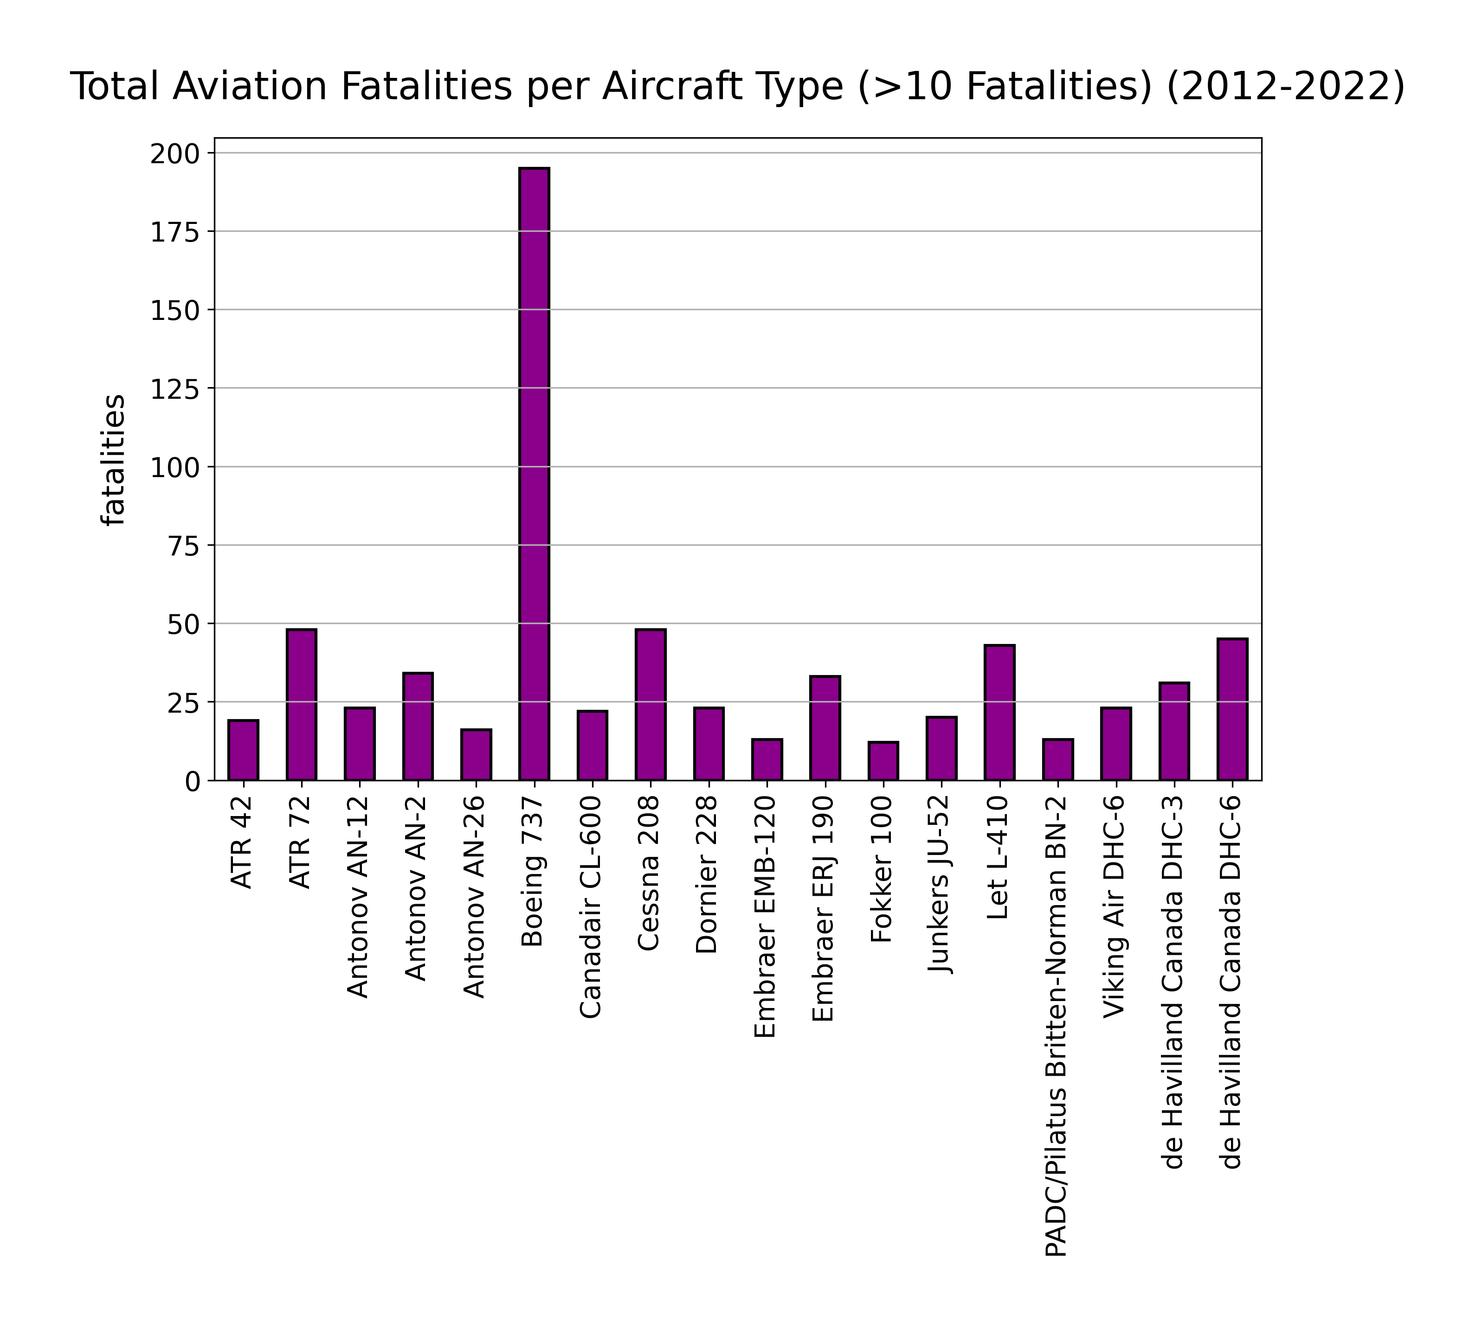
Aviation Accidents Visualization
Analysis:

Slide 14
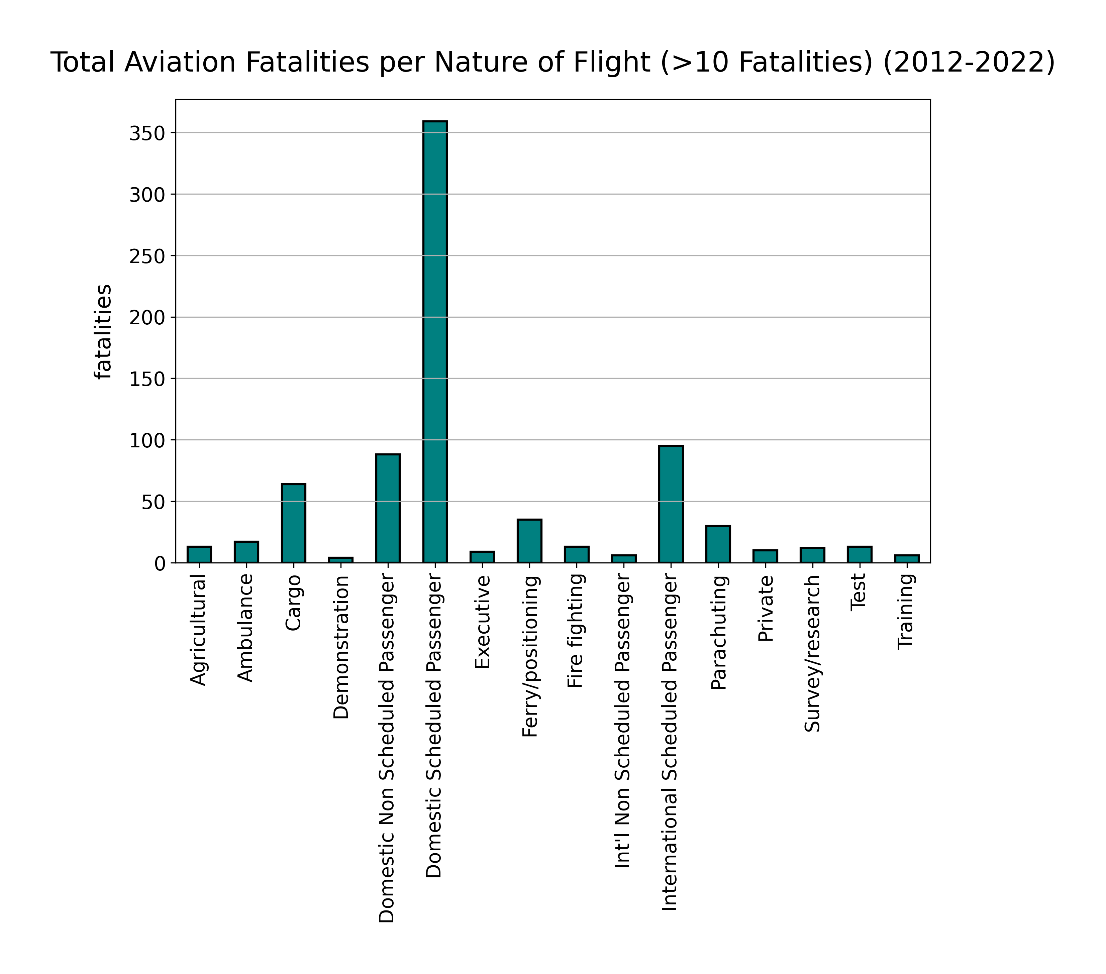
Aviation Accidents Visualization
Analysis:

Slide 15
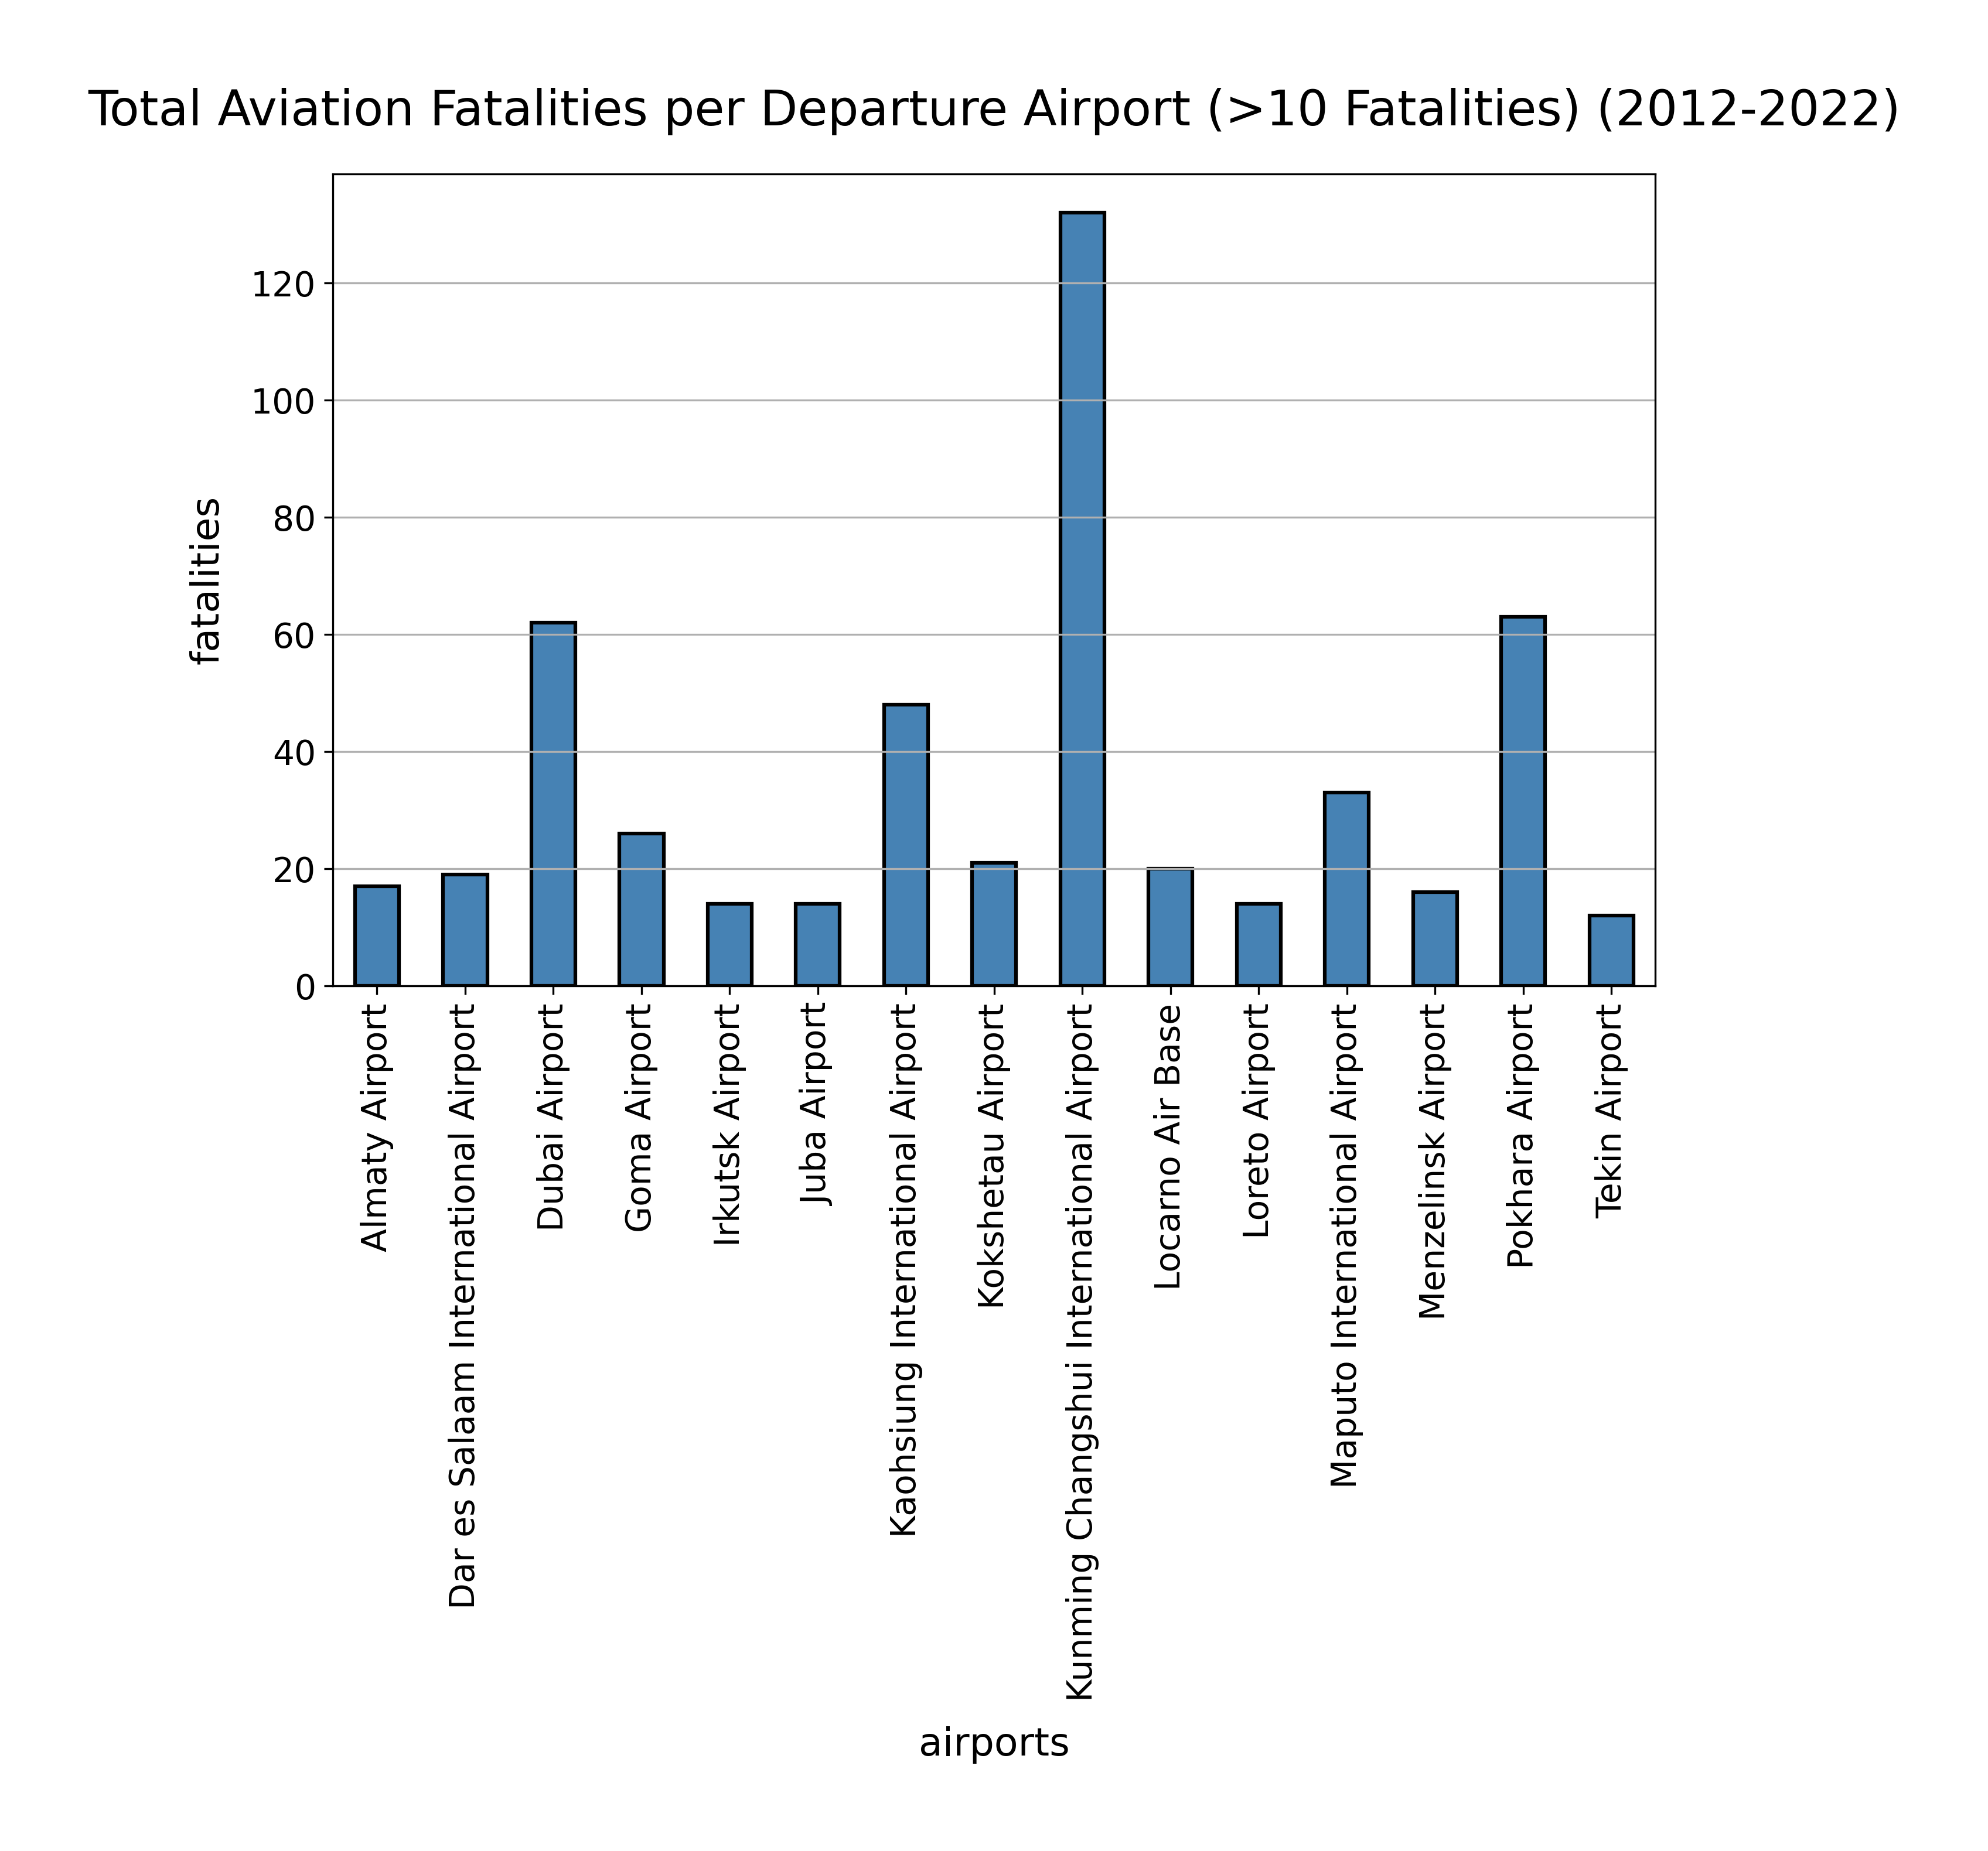
Aviation Accidents Visualization
Analysis:

Slide 16
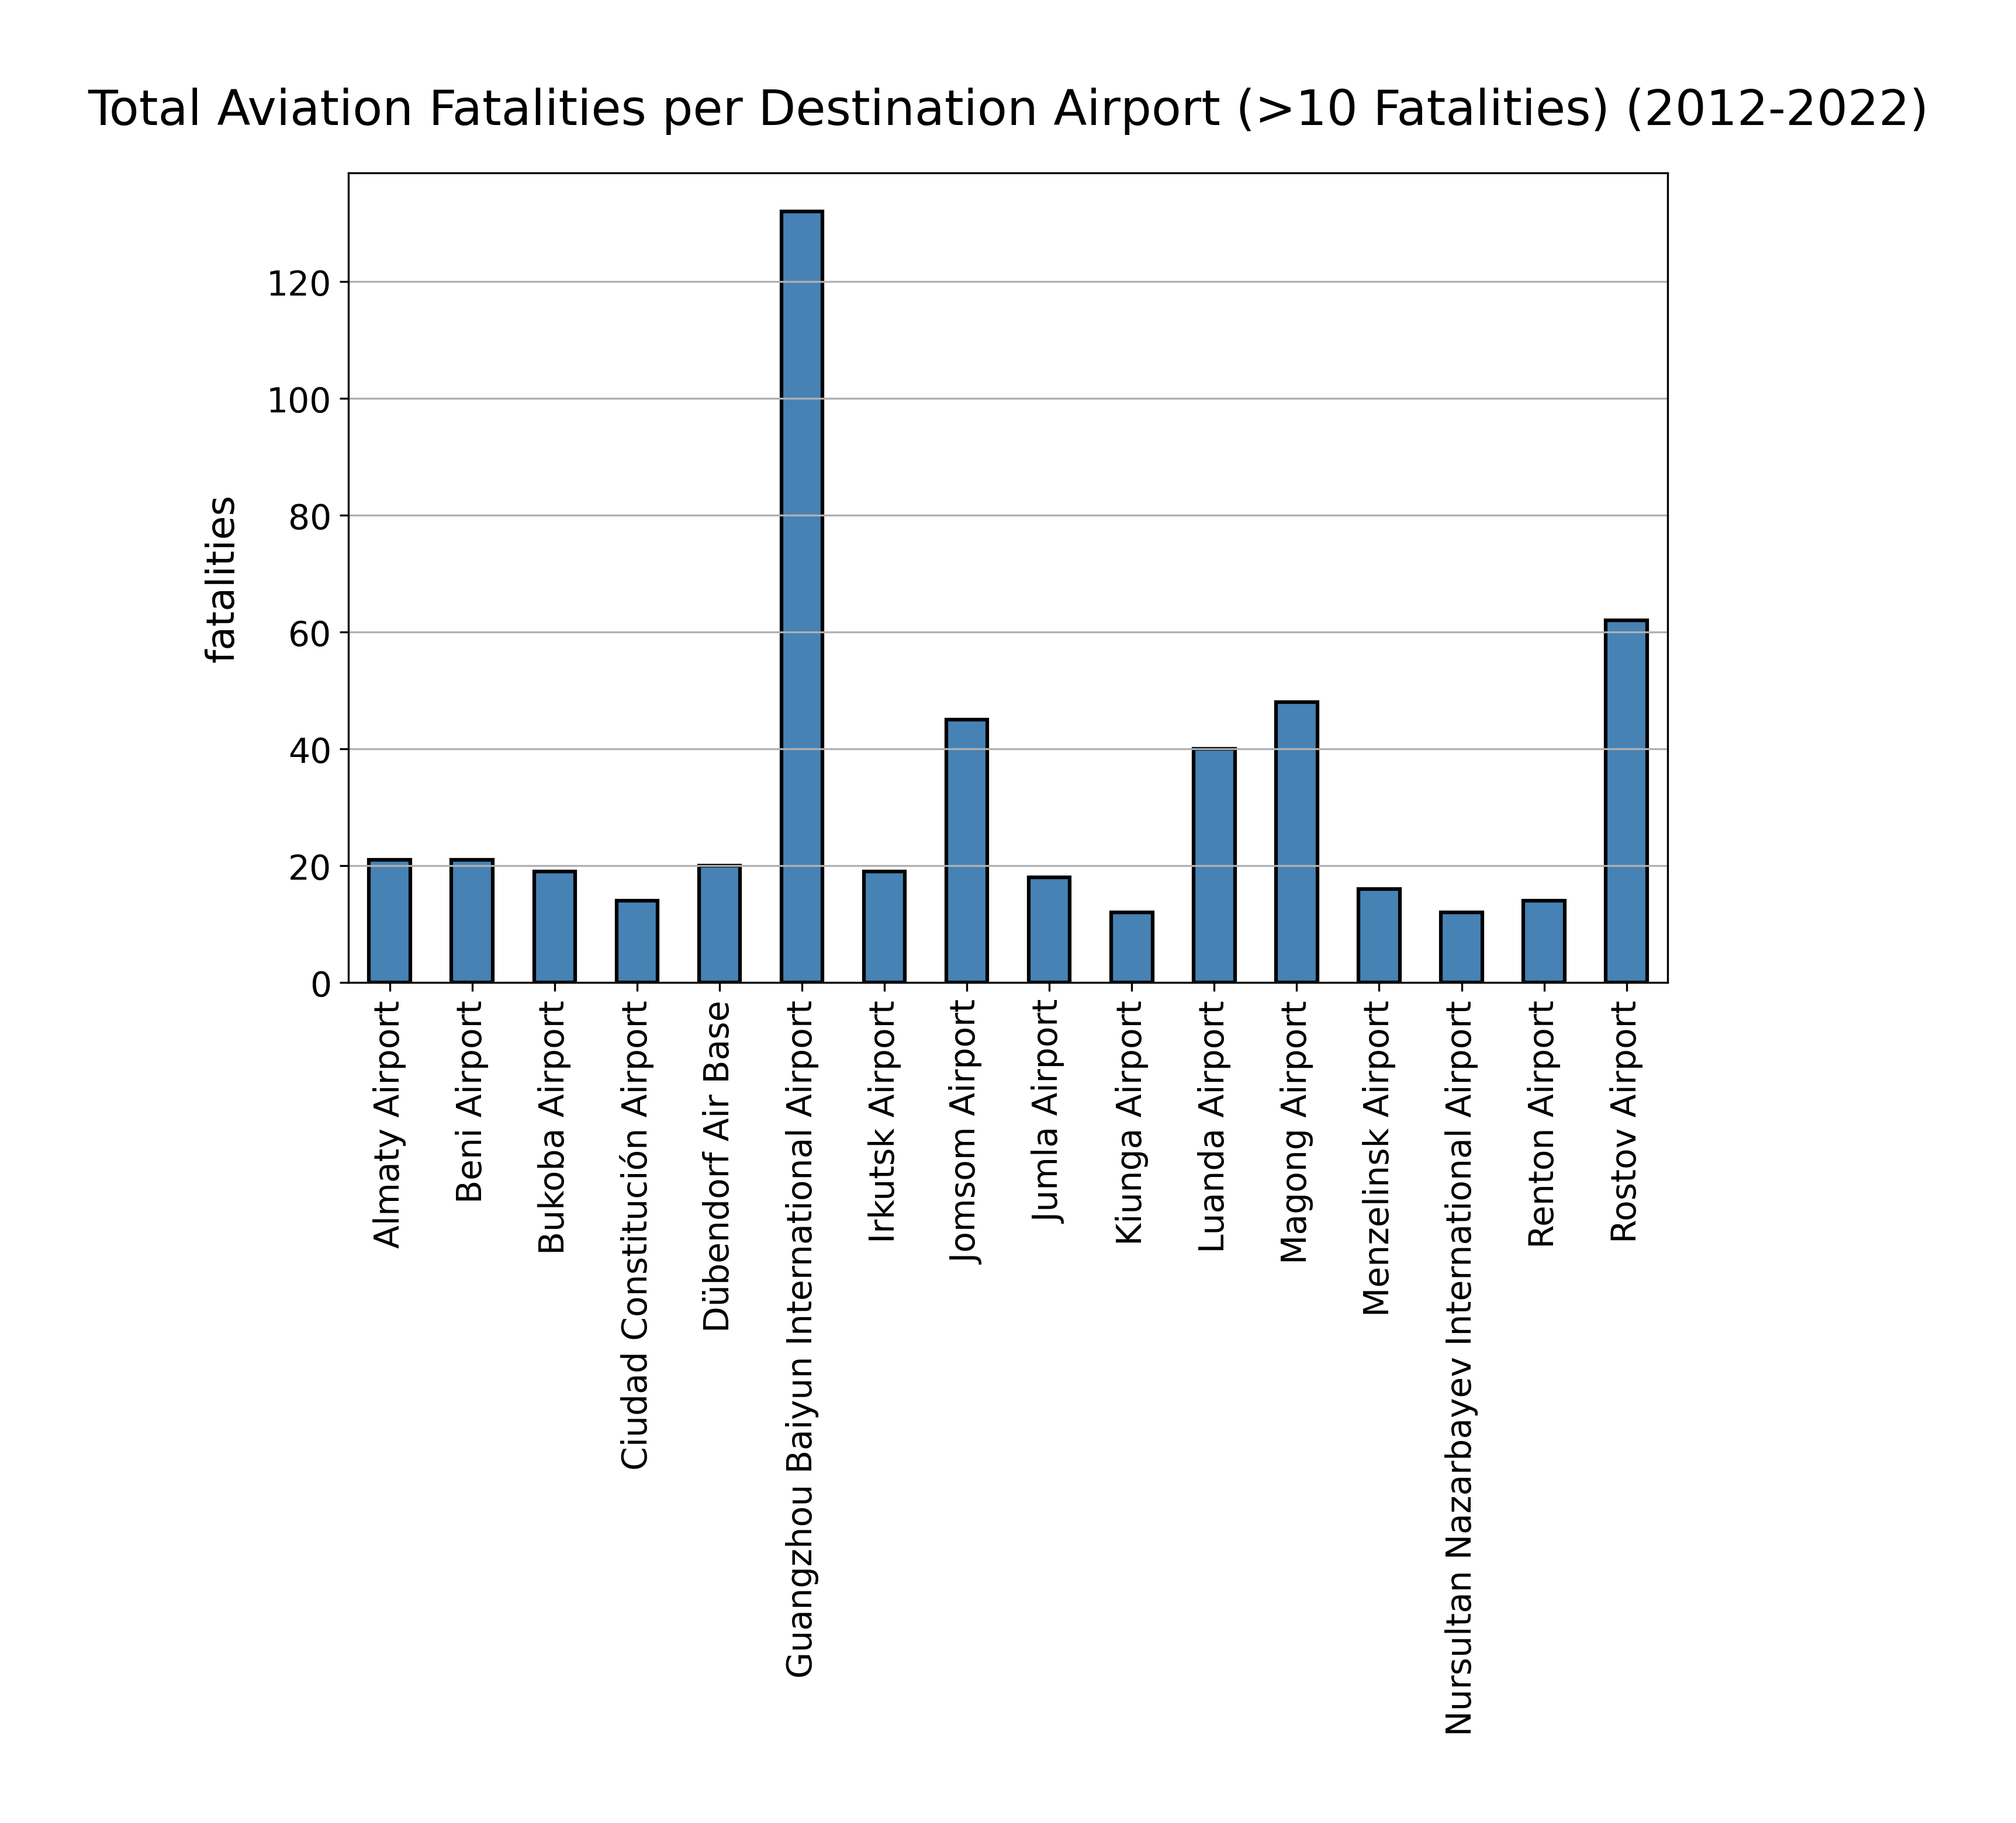
Aviation Accidents Visualization
Analysis:

Slide 17
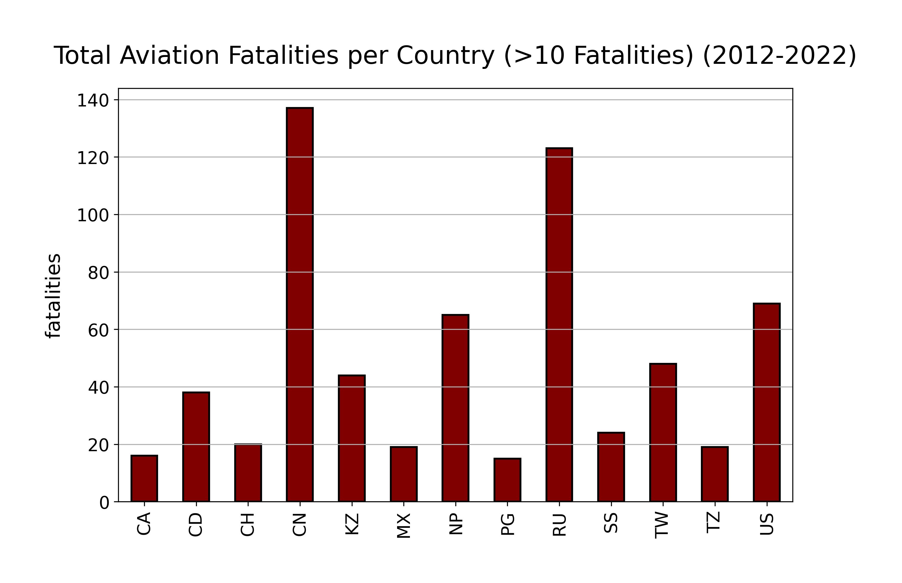
Aviation Accidents Visualization
Analysis:

Slide 18
Aviation Accidents Visualization
Conclusion:
We cannot accurately predict the location of plane crashes only the likelihood based on past events.
During the last ten years, China Eastern Airlines has experienced the largest fatalities.
Possible outside factors for aviation fatalities include terrorism, poor maintenance, and employee negligence or malfeasance
Do not catch the next China Eastern Airlines domestic passenger flight from Kunming Changshui International Airport to Guangzhou Baiyun International Airport on a Boeing 737.

Slide 19

Aviation Accidents Visualization
Questions? Comments?

